Slide 1

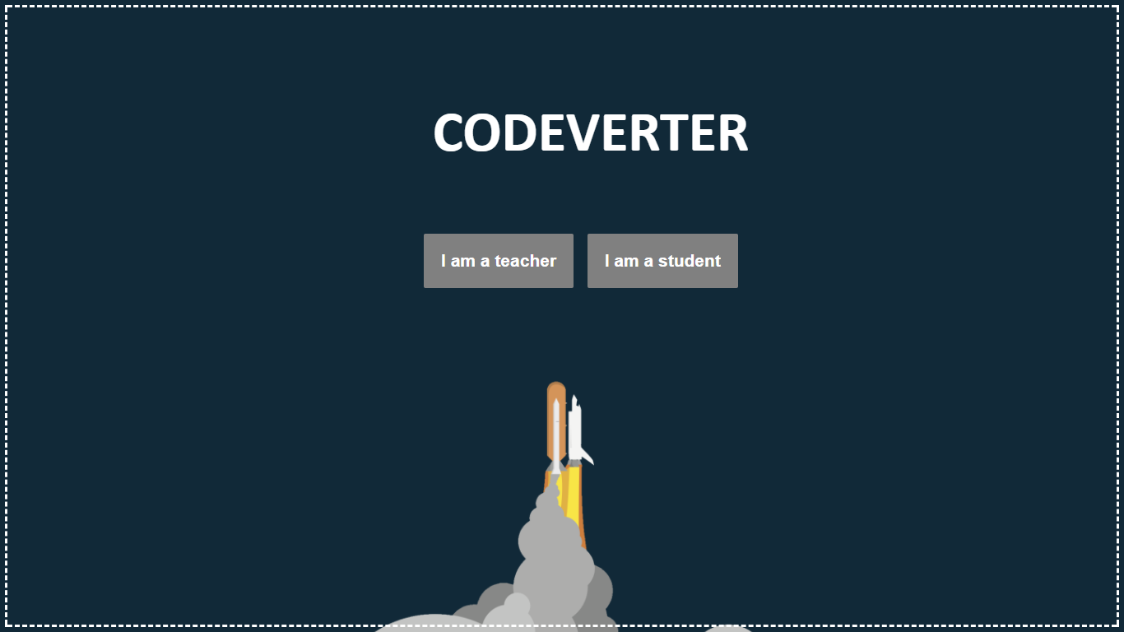
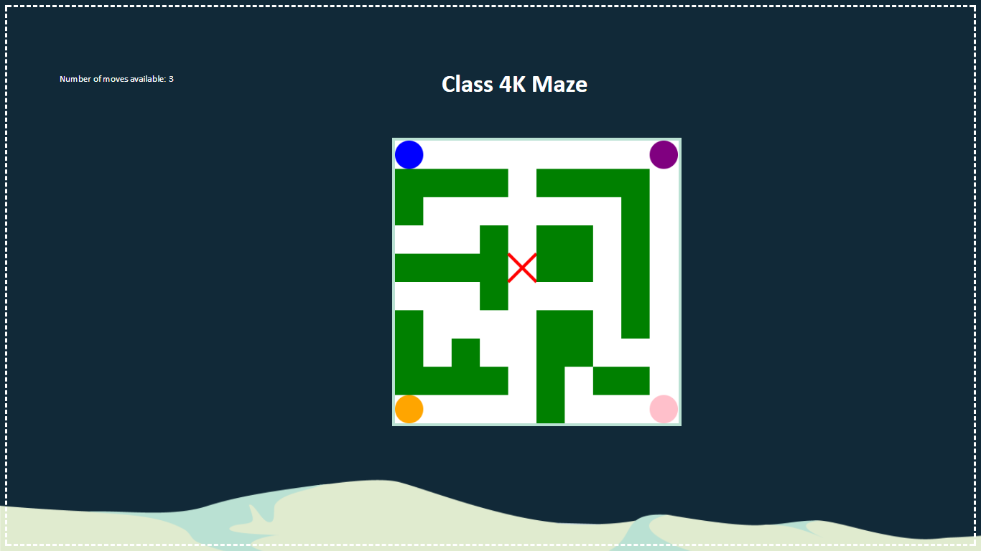

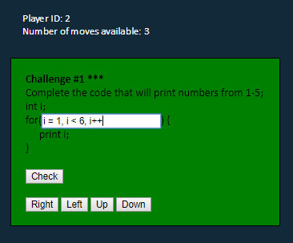
CODEVERTER
The problem:
In some shape or form, technological advancements shape and control just about every aspect of our lives today. As a result children today are growing up in a very different world than previous generations. Currently in Australia more than 90% of the workforce will need digital skills to perform their roles and in the next 2-5 years 60% of students will be studying or training for positions that will become largely automated. Thus in this digital age it’s important for students to start learning how to program from a younger age.
However, when trying to do so, we are faced with a few challenges. It’s not easy to get young people to not only learn such complex concepts, but also get them to take interest in programming. And, not all teachers are equipped with the skills to teach programming.
Our solution:
Codeverter is the concept we have prototyped. A web-based application to be used in primary school classes between the years 3 and 6, with an older student age range being a potential stretch goal. The focus is to make the classroom environment an engaging and social learning environment.
The goal of Codeverter, teaching children coding principles in an engaging and social way, is achieved through several games. Teachers can choose a game, difficulty level, and many other settings to personalise the game according to the needs of the class. Students can also choose to individually practise games or coding exercises.
What is innovative about Codeverter is the emphasis on the social side of learning. The games are focused around group activities and class competitions to engage students better.
For the prototype, we’ve left out a secure login system, and have simple Teacher and Student portals for testing our concept.
Teachers are directed to a screen that shows them the lesson plan for the session, and allows them to choose from two games, a Maze game and a Spaceship game.
The Teacher screen for this prototype will show a large Maze map for the duration of the game, and up to 4 players can join the game in a race to the centre of the map!
The Student screens give students a range of coding problems they must solve in order to get “moves” which allow them to move around the maze in a race to the centre of the board!
There will be more problems when the
program is further developed, but for
the prototype, we have chosen to only
include one problem as this sufficiently
demonstrates the concept in order to
test the social aspect of the games.

Slide 2
The poster should be a conference poster - this requires more information than your usual promotional poster and should highlight the theoretical background/considerations and design process undertaken in addition to describing your solution.
You should describe the domain,
the particular challenge that you are addressing
your solution (the ideal thing),
your representation of the solution (what you ended up with),
the research/design process that got you to where you are now
& future work (acknowledging that your final outcome is a prototype/proof of concept).
A conference poster is allowed to be text-heavy but do consider using dot-points & images to help illustrate your project

